Slide 1


Educational Exam Management System
Desktop Application

Slide 2

Introduction: Why Exam system?
Examination system will reduce effort done by student and Instructors.
Auto Grading
Automation of exam
Flexible assessment
Time Saver
Can be given at any time
More Security

Slide 3



Project Process
FINISH
ENTITY RELATIONSHIP DIAGRAM
Data Base
Dashboards
1
3
5
2
4
6
MAPPING
Reports
(SSRS)
Desktop
Application
START

Slide 4
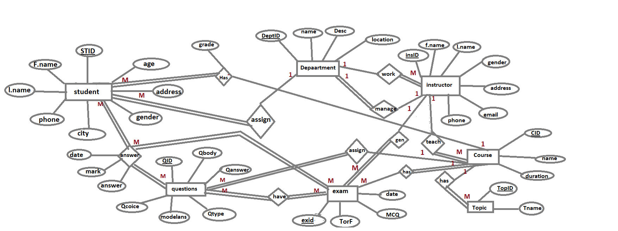
Entity Relationship Diagram

Slide 5
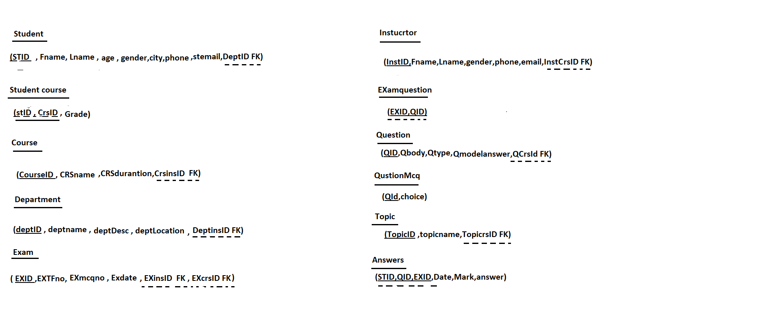
Mapping

Slide 6
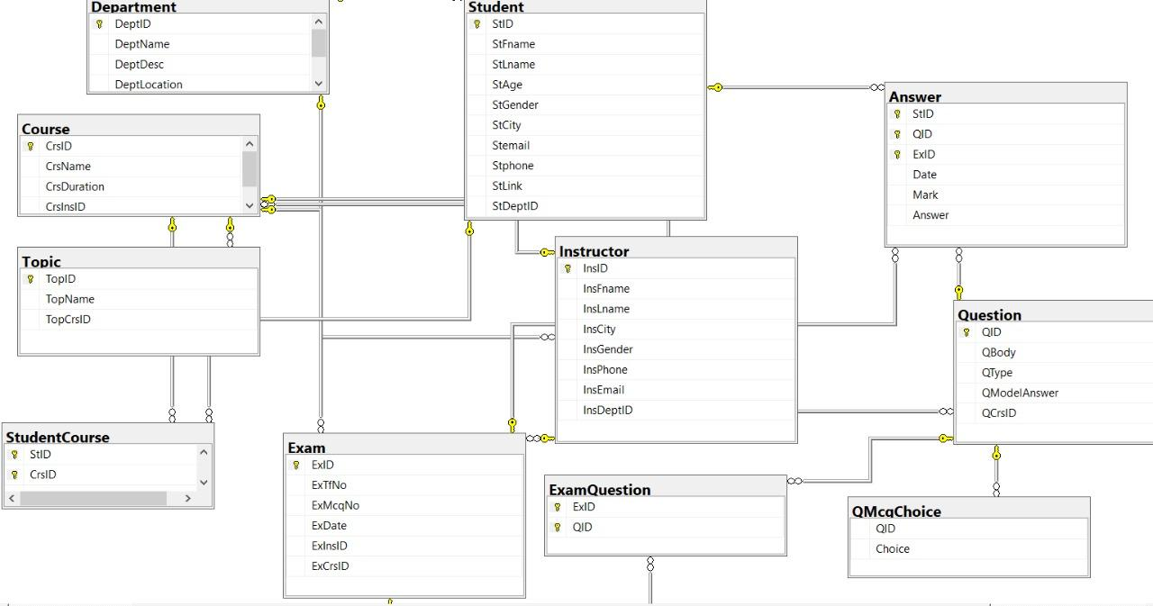
Database Diagram

Slide 7
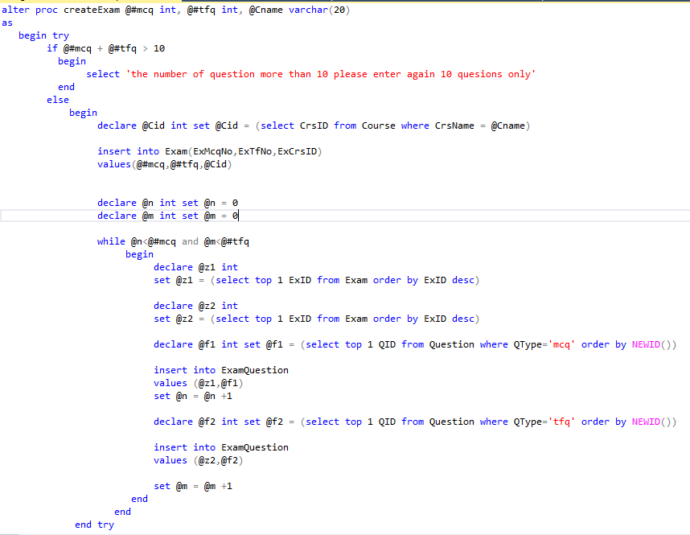
Data base stored Procedures

Slide 8
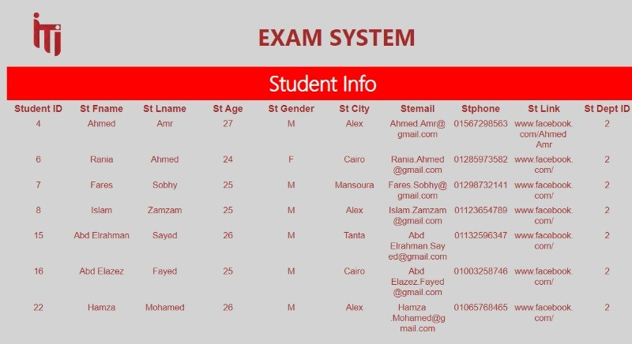
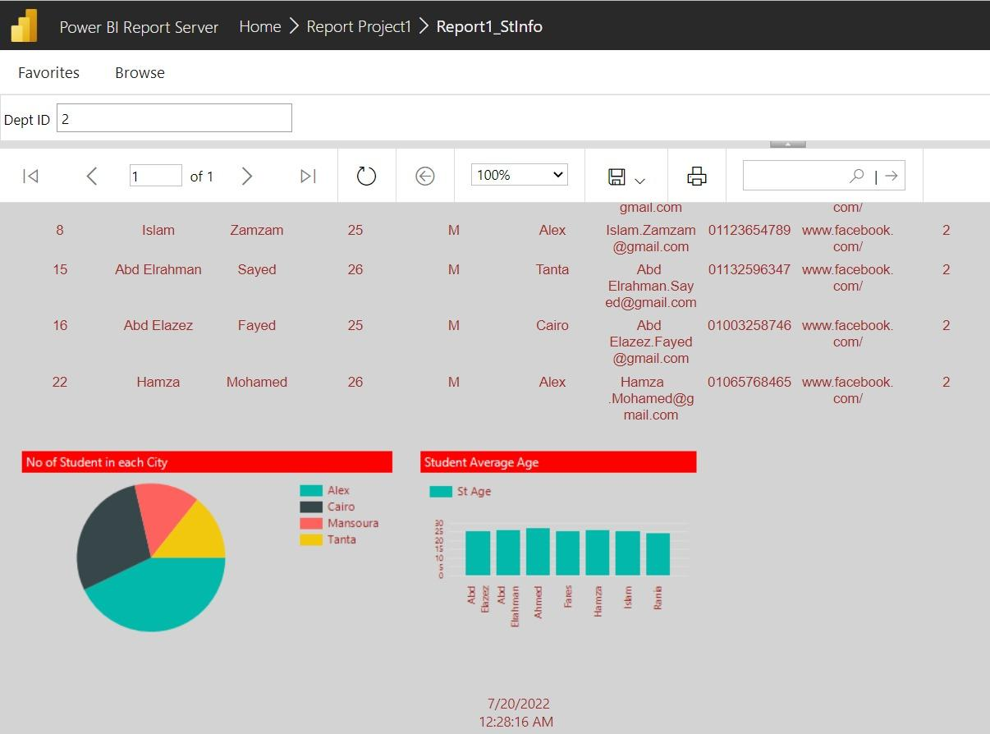
Sample of Reports(SSRS)

Slide 9
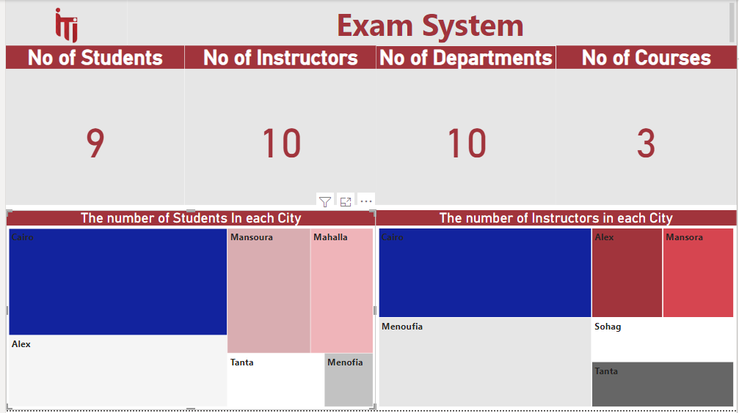
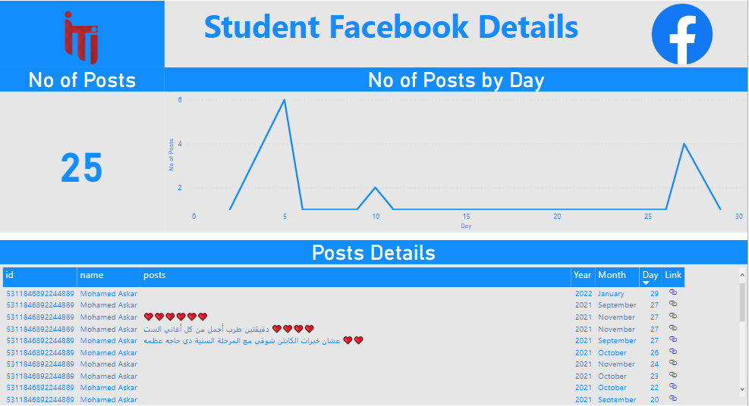
Sample of DashBoards

Slide 10
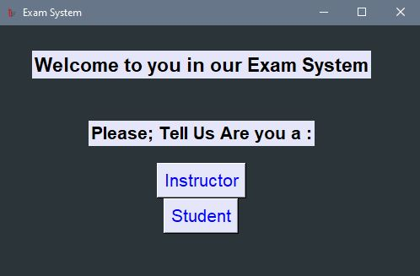
Welcome Page of Desktop App.:

Slide 11
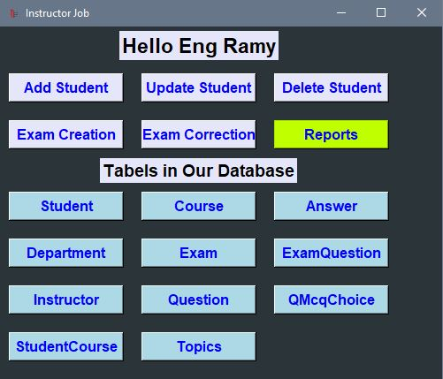
- Instructor controls:

Slide 12
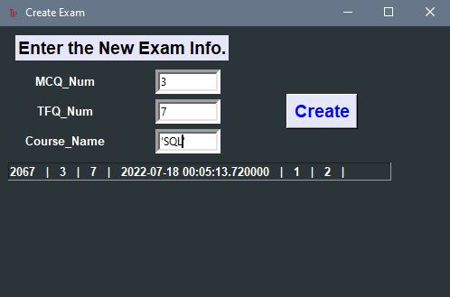
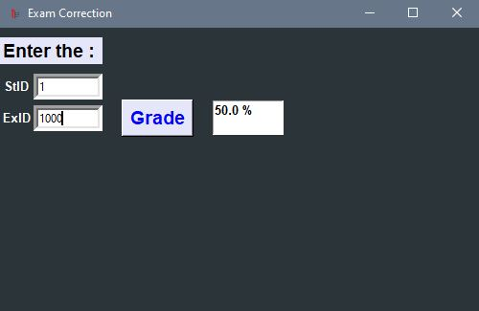
- Exam creation & Correction:

Slide 13
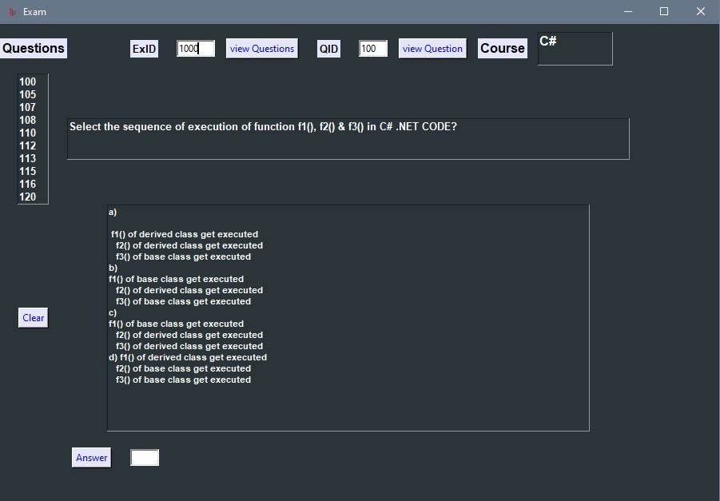
-Start attempting Questions:

Slide 14
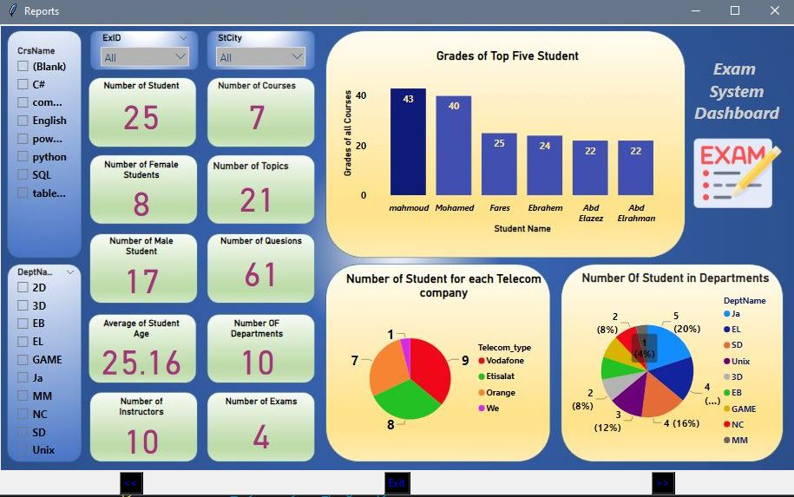
Dashboards in Application

Slide 15

Thank You!

